Slide 1

NEXORA
Unlocking Knowledge, Together

Slide 2
TEAM MEMBERS

Slide 3
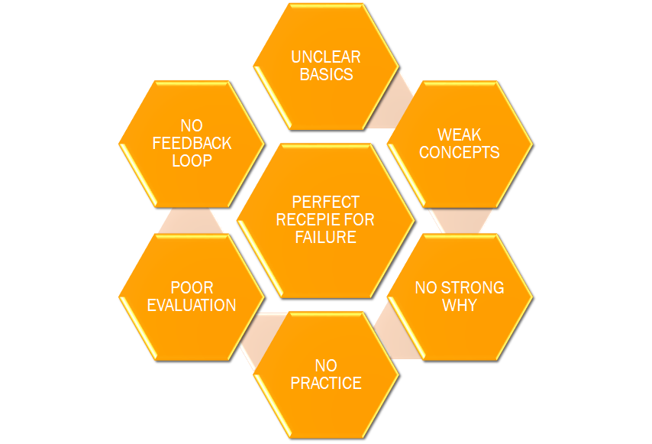
PROBLEM
This is the problem that each and every student in the labs are facing and ultimately deteriorating their progress.

Slide 4
SOLUTION
Understand | LEARN | Practice | redirect
Basic concepts: Explained by teacher in very simple words. | Teacher: Teachers will explain how to code. They will teach the underlying concepts | Students will give the quiz from what they have learnt from the GPT. | The feedback will highlight the weak sections for every student.
GPT aided discussions: Students will understand the taught concepts in detail by discussing the concepts with the GPT. | GPT aided coding assistance: Students will the take the idea of how the features can be implemented. | Each question is time based (30 sec) so that they cannot cheat from the GPT. | Students can see the reference videos or consult the teacher
Further confusions can be discussed with the teachers. | Direct solution viewing is monitored. | Instant feedback reflecting their weak will be given. | Again the quiz will be provided to check if the student understood.

Slide 5
KEY POINTS
By making the GPT enabled into the Nexora, the students will get well versed with the prompt engineering at least in their domain.
After completing their learning path, GPT will provide them with the interview and most asked questions related to the topic they have recently learnt.
Students will have a clear understanding of their weak points and teacher can help them in that certain area.
Students can explore ideas from GPT but cannot copy experiments. A temporary database will track searches, allowing teachers to monitor activity. If a student searches for a direct solution, they will be highlighted.
This whole thing can be divided into two lectures, first for learning the concepts and second for the practice, quiz, and interview questions.

Slide 6
WHAT PROBLEMS ARE SOLVED
Students are actually gaining skills
Their two lab lectures are getting invested into actual learning.
Students are getting prepared for their placement and interview.
A great initiative to make the individuals move from students to learners.
The students who have already studied certain topics can upskill themselves by giving more time for the practice, quiz, and problem solving.

Slide 7
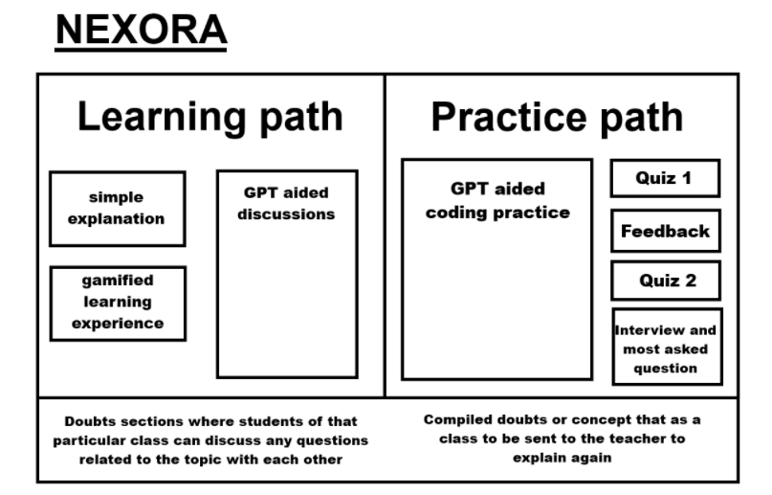
THE MODEL WILL LOOK LIKE

Slide 8

THANK YOU

